Slide 1

EN2091 - Laboratory Practice and Projects
VARIABLE VOLTAGE
LINEAR POWER SUPPLY
By Team Wave-Formers

Slide 2

INTRODUCTION
This project is to design and implement a variable voltage linear power supply. The power supply is designed to provide a regulated DC output voltage ranging from 2V to 20V, with a maximum current output of 2.5A.

Slide 3
Transformer | 24 V(rms) , 5A
Bridge Rectifier | BR 5010
Voltage Regulator | LD1085CT
Transistors | TIP 142 (Darlington), 2N3904
Zener Diodes | 24V (1W)
Potentiometers | 10K ,20K
Capacitors | 2200uF , 10uF , 22nF
Resistors | -
Digital Multimeter
COMPONENTS

Slide 4
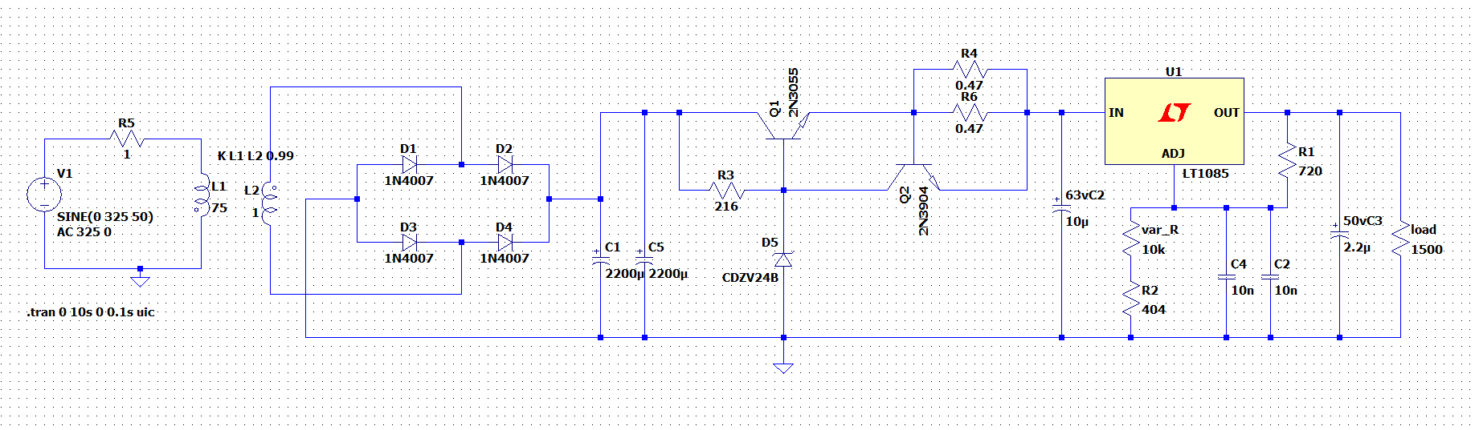
SPICE MODEL

Slide 5
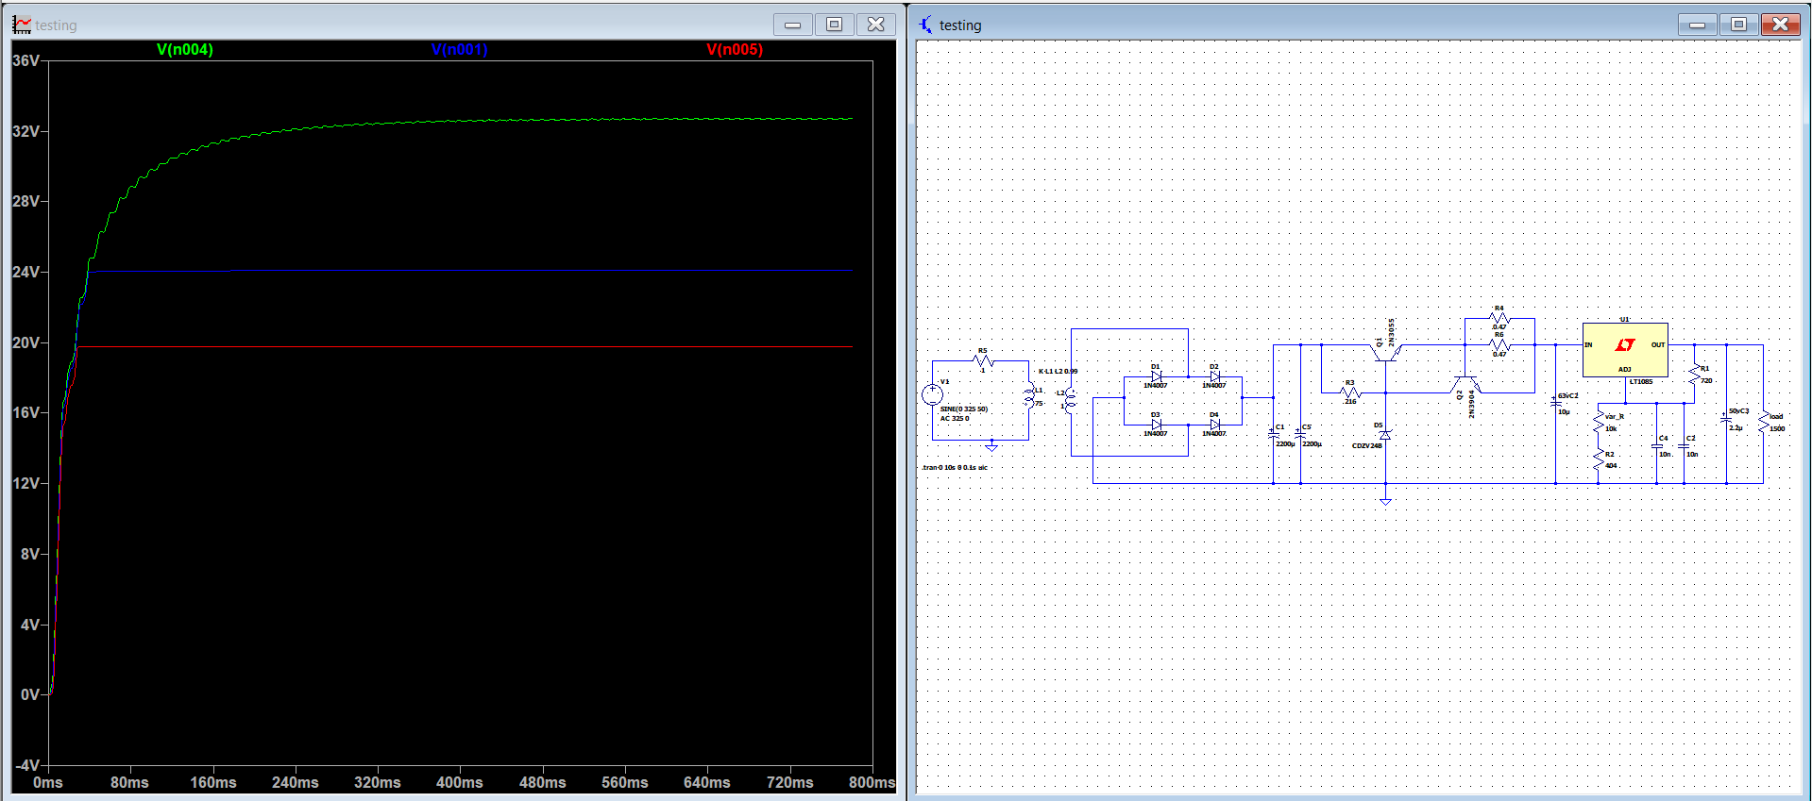
SIMULATION (LT-SPICE)

Slide 6
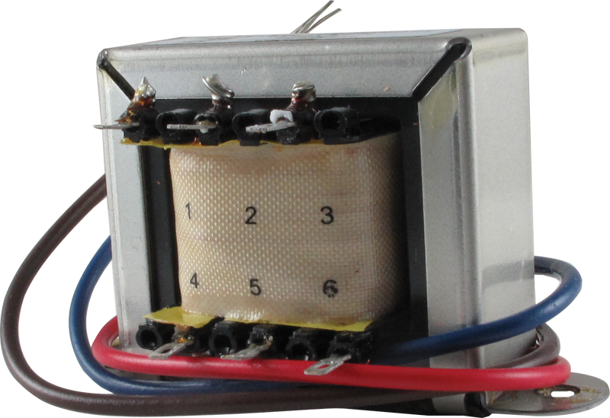
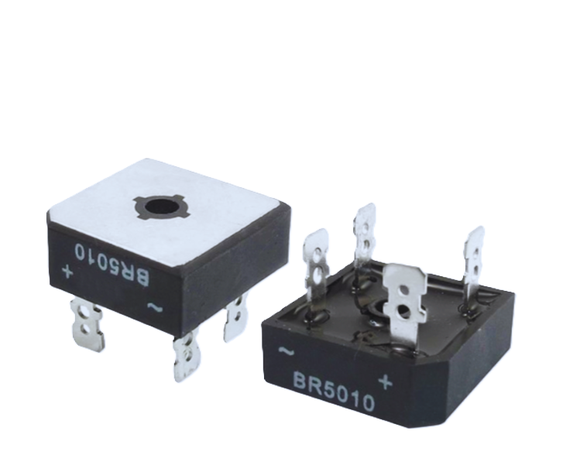
VOLTAGE RECTIFICATION
Component: BR5010 Bridge Rectifier
Max Reverse Voltage (PIV): 1000V
Max Forward Current: 50A
Forward Voltage Drop: ~1V per diode (2V total for a bridge rectifier)
Input: 24V AC from transformer
Output: 34V peak rectified DC voltage
Component: 24V 5A Transformer
Input Voltage: 230V AC, 50Hz
Output Voltage: 24V AC
Current Rating: 5A (max)
DATASHEET:
https://www.alldatasheet.com/datasheet-pdf/download/58688/DCCOM/BR5010.html

Slide 7
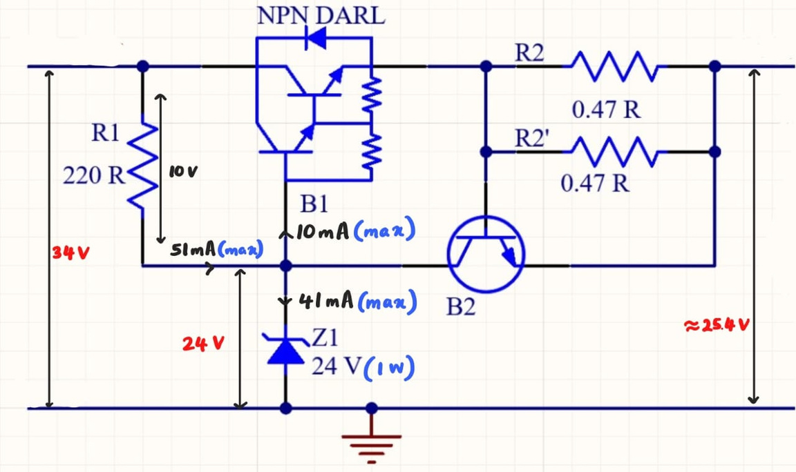

VOLTAGE REGULATING & CURRENT LIMITING CIRCUIT
NPN Darlington Transistor (TIP142): The passing element for the regulation circuit.
Max Ic = 2.5A (max current supply)
Vce = (34 - 25.4) V = 9.6 V
Max Power Dissipation
= 2.5A x 9.6 V
= 24 W
TIP142 :
max current: 10 A
max Power Dissipation = 125 W
24V Zener Diode: Sets the base voltage of the TIP142, allowing it to be used for the initial voltage regulation.

Slide 8

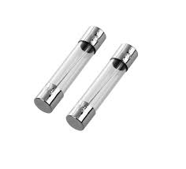
VOLTAGE REGULATING & CURRENT LIMITING CIRCUIT
NPN Transistor (2N3904): The passing element for the current limiter circuit.
Operating V be = 0.672 V (Measured)
0.672 V
0.26R
I max =
Equivalent Resistance = 0.26 R (Measured)
Current Limitation = 2.58 A (Calculated)
For Short Circuit Protection,
3 A Fuse used

Slide 9
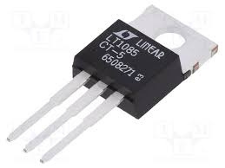
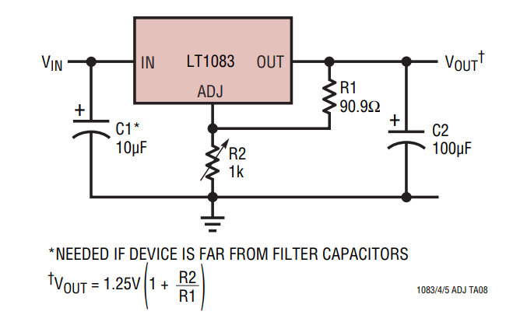
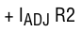
VOLTAGE VARIATION
LT1085 Voltage Regulator IC: Provides further ripple reduction and adjustable output voltage. (I max = 3A)
This IC is used as a adjustable voltage regulator .The voltage of the output pin is varied by changing the voltage at the adjustable pin using a 10K potentiometer.

Slide 10
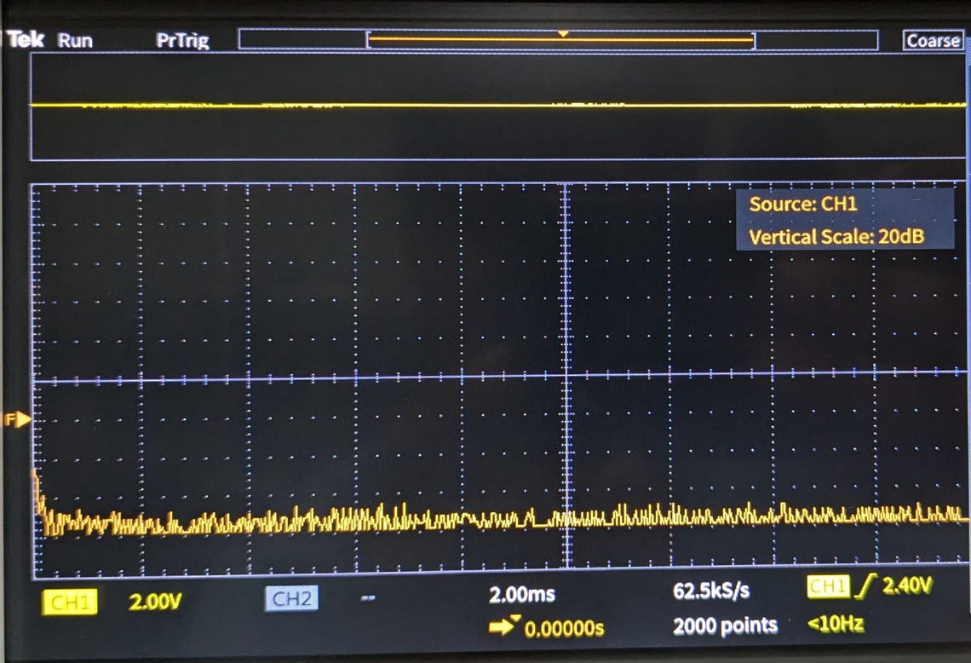
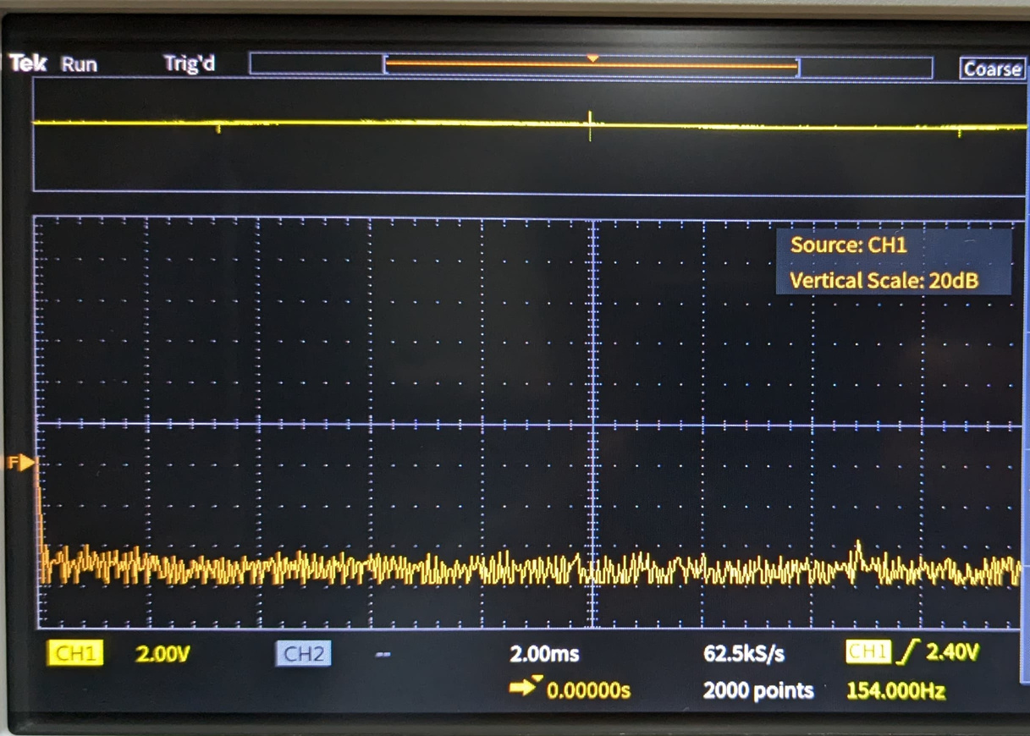
NOISE
With probe connected
Without probe connected

Slide 11
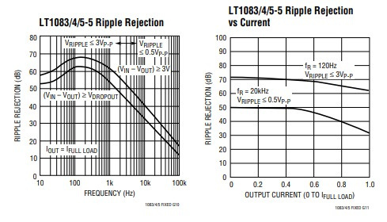
SMOOTHING EFFECT AND RIPPLE REJECTION
Required smoothing capacitor value - 42.5mF (Calculated)
Used smoothing capacitor value - 4.4mF(Tested)
LT1085 has high ripple rejection ratio around 70dB at 100 Hz.

Slide 12
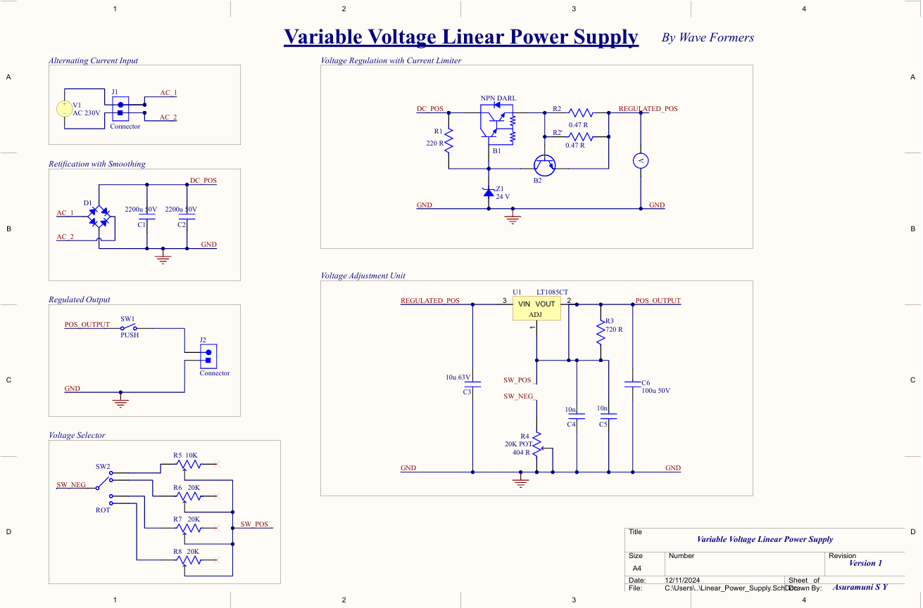
SCHEMATIC

Slide 13
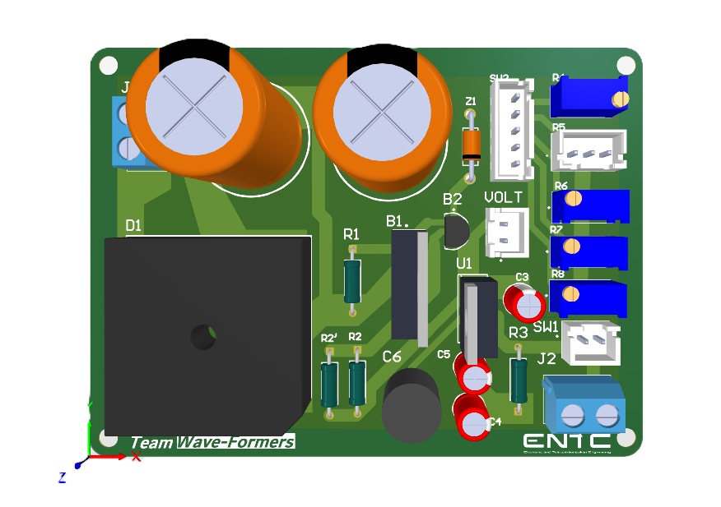
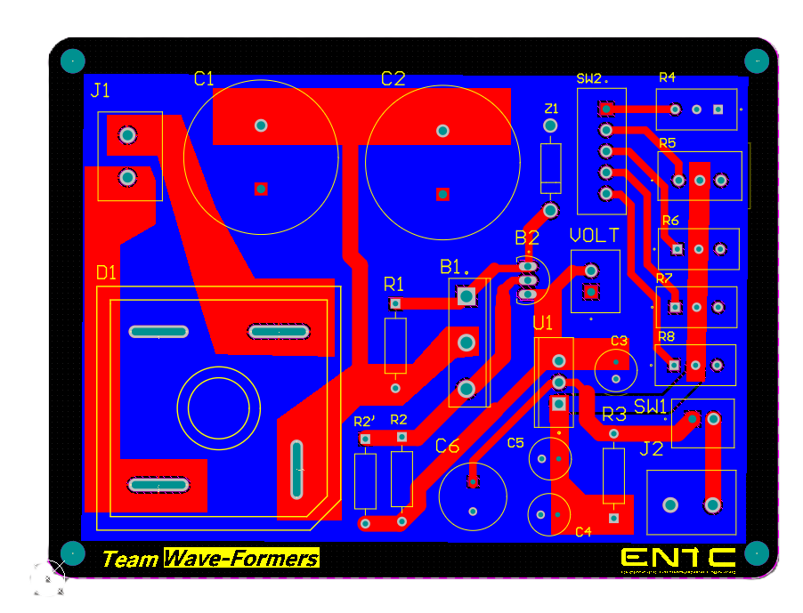
PCB DESIGN
Designed using Altium Designer and manufactured by JLCPCB
2 layer pcb - 1oz copper
Dimensions - 86.4mm x 64.0mm

Slide 14
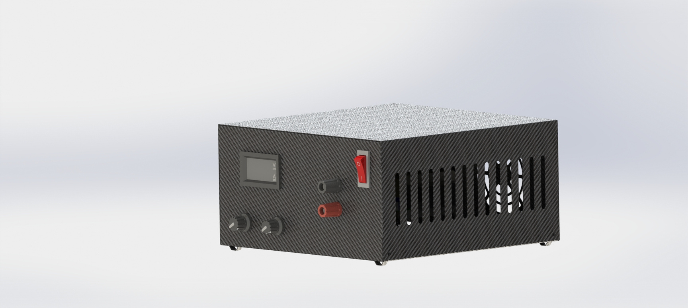
ENCLOSURE DESIGN
Designed using SOLIDWORKS (sheet-metal design)
Dimensions (LxWxH) | 20 cmx 20 cm x 10cm
Material | Zn coated steel (0.8mm)
Material Weight | ~500 g
Total Weight | ~3.2 Kg

Slide 15
TEAM MEMBERS & TASK ALLOCATION
220046R ASURAMUNI S. Y.
220280D JAYAWARDENA H.D.S.S.
PCB Design
Circuit Design
Testing & Debugging
PCB Design
Product Assembly
Component selection
220429U NIMANTHA K.L.W.O.
220692R WERAGODA W.A.A.P.
Circuit Design & Calculations
Enclosure Design
Component selection
Product Assembly
Documentation
Testing & Debugging

Slide 16
THANK YOU

